Slide 1
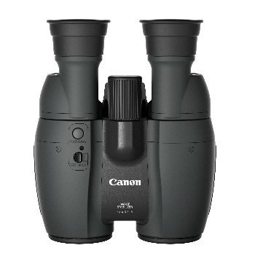
12x32 IS
12x32 IS Binoculars THE IDEAL HIGH QUALITY BINOCULAR
Get closer to a wide range of subjects using these premium 12x binoculars. With Canon precision optics and a Powered Image Stabilizer to counteract movement, they deliver superbly bright handheld detail for easy and comfortable subject identification.
Cutting Edge Lens Performance
Canon binoculars feature cutting edge optical technology cultivated in the development of the EOS series DSLR camera lenses. All models are also equipped with Image Stabilizer to maximize the performance of the lenses.
Compact Design
Experience a clean and compact design. Clever contrasting textures, rounded corners and tapering contours make the binocular’s already-small frame appear even smaller. A superb pair of binoculars inside and out – perfect size to bring when travelling or viewing sports/ wildlife.

Slide 2
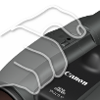
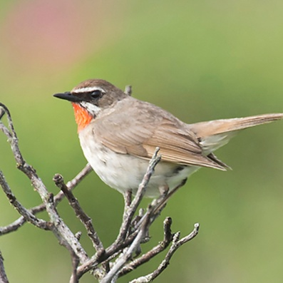
12x32 IS
THE IDEAL HIGH QUALITY BINOCULAR
Powered IS
A mode that delivers more powerful image stabilization than normal IS for strong shaking or natural body movements. This feature makes long observations more comfortable by providing a more stable image when focusing on a single point that does not move much.
Magnification
12x Magnification
Get closer to a wide range of subjects with the 12x magnification within these binoculars.
12 x
The non-slip finger grips make the binoculars easy to hold for a stable, easy viewing experience.
Ergonomic Grip
IS Button
A single push of a button activates IS for five minutes, allowing you to focus on viewing your subjects.
Optical Quality
All models use a Porro prism design that priorities resolution and brightness. It also includes a multi-layer coating which reduces flaring and ghosting, perfect for everyday viewing.
Brightness
This pair of binoculars has a medium sized diameter, which allows for a balance of portability and superb brightness.
Focusing Distance
The minimum distance viewing has been reduced to 2m, meaning that you can now enjoy viewing objects or creatures at a close range.
The field flattener lens corrects any blurring of edges when viewing a specific image, resulting in a sharp image across the entire field of view.
Crisp Images
What is this pair of binoculars best used for ?

Slide 3
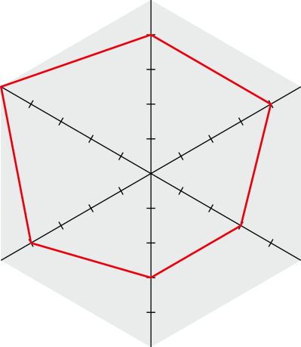
Technical Specifications
12x32 IS
Magnification
IS
performance
4
5
Wide field
of view
4
4
3
Portability
3
Brightness
Waterproof
Magnification | 12 x
Objective lens effective diameter | 32 ｍｍ
Real field of view | 5.0° (87.3 m field of view at 1000 m)
Apparent field of view | 55.3°
Pupil diameter | 2.3 mm
Eye relief | 14.5 mm
Closest focusing distance | 6.6 ft. / 2.0 m
L/R dioptric difference adjustment range | ±3.0 dpt
Eye width adjustment range | 55 - 76 mm
Image stabilizer function | Available (5 minute continuous operation with a single push) (with Powered IS)
Image stabilization method | Shift method
Power source (when using IS) | 2 AA batteries At normal temperature: (25℃): Approx. 10 hours (NiMH batteries can also be used) At low temperature: (-10℃): Approx. 2 hours (NiMH batteries can also be used)
Prism type | Porro II type prism
UD lens | ー
Super Spectra Coating | ●
Field flattener element | ● (2)
Waterproof construction | ー
Tripod socket | ー
W x L x H | 5.6 x 6.7 x 3.0 in. / 142 × 171 × 77 mm
Weight (Except for batteries) | Approx. 27.5 oz. / 780 g
Package contents | Soft case, strap, ocular lens cap
Optional accessories | Anti-Fog Eyepiece AE-B1

